Slide 1
EE2211 Tutorial 2
(remember to sign your attendance on the sheet of paper)

Slide 2

Telegram group
https://t.me/+Km551k0ohZ1jYmQ1

Slide 3
Lecture recap

Slide 4
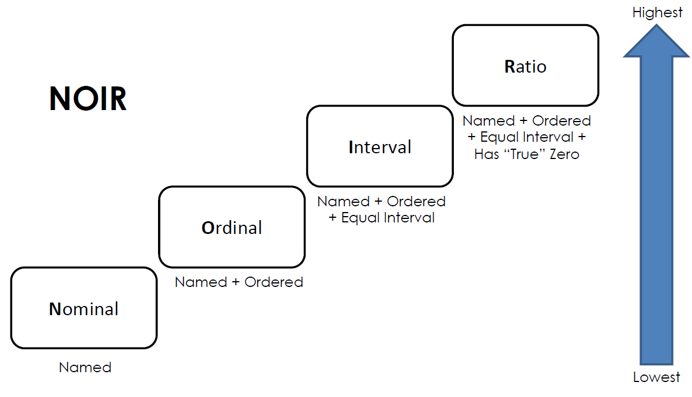
NOIR

Slide 5
Mean, median, mode
Mean: Average
Median: Number in the middle (after sorting)
Mode: Most common value

Slide 6
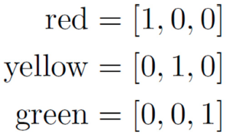
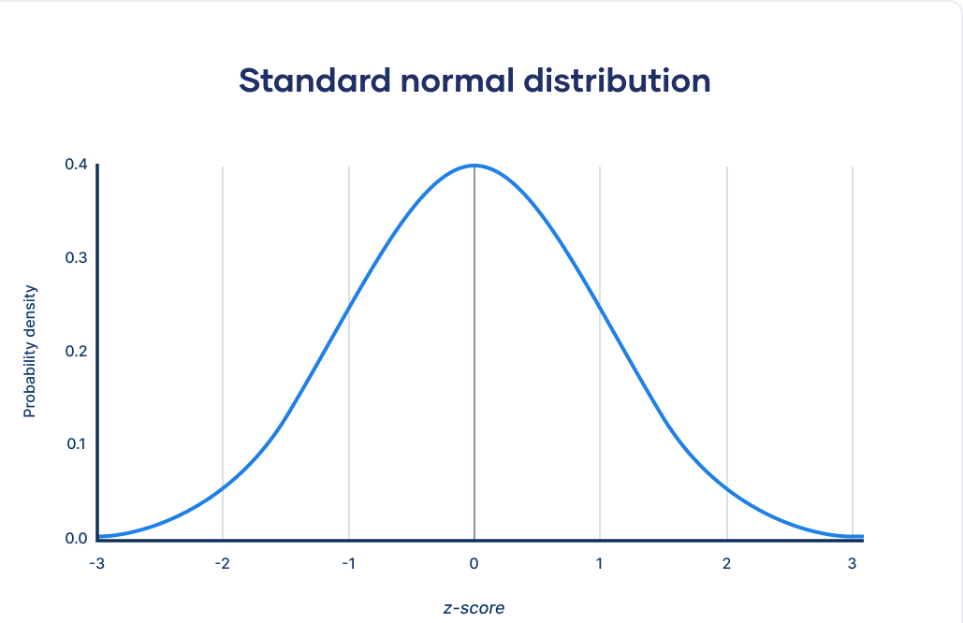
Formatting data
Binary coding
One-hot encoding
Normalization
Linear scaling
Scale each variable to between [0, 1]
Z-score standardization
Normally distribute the data

Slide 7
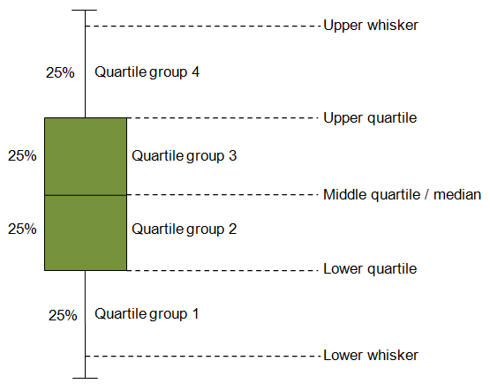
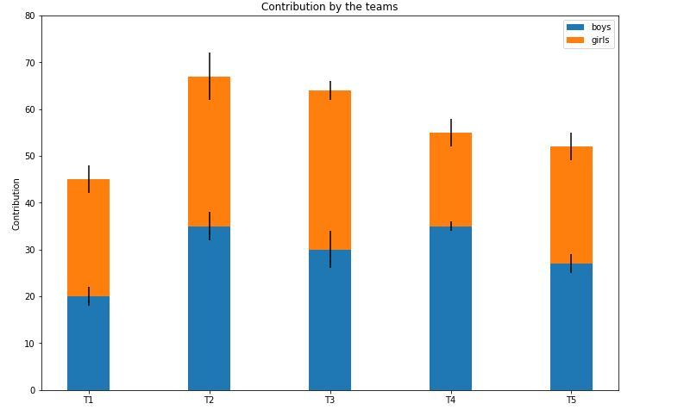
Visualizing data
Bars
Boxplots

Slide 8
Tutorial 2

Slide 9
Question 1
A Comma Separated Values (CSV) file is a plain text file that contains a list of data. These files are often used for exchanging data between different applications. Download the file “government-expenditure-on-education.csv” from https://data.gov.sg/dataset/government-expenditure-on-education. Plot the educational expenditure over the years. (Hint: you might need “import pandas as pd” and “import matplotlib.pyplot as plt”.)

Slide 10
Question 2
Download the CSV file from https://data.gov.sg/dataset/annual-motor-vehicle-population-by-vehicle-type. Extract and plot the number of Omnibuses, Excursion buses and Private buses over the years as shown below. (Hint: you might need “import pandas as pd” and “import matplotlib.pyplot as plt”.)

Slide 11
Question 3
The “iris” flower data set consists of measurements such as the length, width of the petals, and the length, width of the sepals, all measured in centimeters, associated with each iris flower. Get the data set “from sklearn.datasets import load_iris” and do a scatter plot as shown below. (Hint: you might need “from pandas.plotting import scatter_matrix”)

Slide 12
Question 4
You are given a set of data for supervised learning. A sample block of data looks like this:
Each row corresponds to a sample data measurement with 5 input features and 1 response.
1.2234, 0.3302, 123.50, 0.0081, 30033.81, 1
1.3456, 0.3208, 113.24, 0.0067, 29283.18, -1
0.9988, 0.2326, 133.45, 0.0093, 36034.33, 1
1.1858, 0.4301, 128.55, 0.0077, 34037.35, 1
1.1533, 0.3853, 116.70, 0.0066, 22033.58, -13
1.2755, 0.3102, 118.30, 0.0098, 30183.65, 1
1.0045, 0.2901, 123.52, 0.0065, 31093.98, -1
1.1131, 0.3912, 113.15, 0.0088, 29033.23, -1
What kind of undesired effect can you anticipate if this set of raw data is used for learning?

Slide 13
Question 4
You are given a set of data for supervised learning. A sample block of data looks like this:
Each row corresponds to a sample data measurement with 5 input features and 1 response.
1.2234, 0.3302, 123.50, 0.0081, 30033.81, 1
1.3456, 0.3208, 113.24, 0.0067, 29283.18, -1
0.9988, 0.2326, 133.45, 0.0093, 36034.33, 1
1.1858, 0.4301, 128.55, 0.0077, 34037.35, 1
1.1533, 0.3853, 116.70, 0.0066, 22033.58, -13
1.2755, 0.3102, 118.30, 0.0098, 30183.65, 1
1.0045, 0.2901, 123.52, 0.0065, 31093.98, -1
1.1131, 0.3912, 113.15, 0.0088, 29033.23, -1
What kind of undesired effect can you anticipate if this set of raw data is used for learning?
Those features with very large values may overshadow those with very small values.

Slide 14
Question 4
You are given a set of data for supervised learning. A sample block of data looks like this:
Each row corresponds to a sample data measurement with 5 input features and 1 response.
1.2234, 0.3302, 123.50, 0.0081, 30033.81, 1
1.3456, 0.3208, 113.24, 0.0067, 29283.18, -1
0.9988, 0.2326, 133.45, 0.0093, 36034.33, 1
1.1858, 0.4301, 128.55, 0.0077, 34037.35, 1
1.1533, 0.3853, 116.70, 0.0066, 22033.58, -13
1.2755, 0.3102, 118.30, 0.0098, 30183.65, 1
1.0045, 0.2901, 123.52, 0.0065, 31093.98, -1
1.1131, 0.3912, 113.15, 0.0088, 29033.23, -1
What kind of undesired effect can you anticipate if this set of raw data is used for learning?
Those features with very large values may overshadow those with very small values.
(b) How can the data be preprocessed to handle this issue?

Slide 15
Question 4
You are given a set of data for supervised learning. A sample block of data looks like this:
Each row corresponds to a sample data measurement with 5 input features and 1 response.
1.2234, 0.3302, 123.50, 0.0081, 30033.81, 1
1.3456, 0.3208, 113.24, 0.0067, 29283.18, -1
0.9988, 0.2326, 133.45, 0.0093, 36034.33, 1
1.1858, 0.4301, 128.55, 0.0077, 34037.35, 1
1.1533, 0.3853, 116.70, 0.0066, 22033.58, -13
1.2755, 0.3102, 118.30, 0.0098, 30183.65, 1
1.0045, 0.2901, 123.52, 0.0065, 31093.98, -1
1.1131, 0.3912, 113.15, 0.0088, 29033.23, -1
What kind of undesired effect can you anticipate if this set of raw data is used for learning?
Those features with very large values may overshadow those with very small values.
(b) How can the data be preprocessed to handle this issue?
We can either use min-max or z-score normalization to resolve the problem.

Slide 16
Question 5
The Pima Indians Diabetes Dataset involves predicting the onset of diabetes within 5 years in Pima Indians given medical details. Download the Pima-Indians-Diabetes data from https://raw.githubusercontent.com/jbrownlee/Datasets/master/pima-indians-diabetes.data.csv.

Slide 17
Question 6
Disease Outbreak Response System Condition (DORSCON) in Singapore is a colour-coded framework that shows the current disease situation. The framework provides us with general guidelines on what needs to be done to prevent and reduce the impact of infections. There are 4 statuses – Green, Yellow, Orange and Red, depending on the severity and spread of the disease. Which types of data does DORSCON belong to ?
Categorical
Ordinal
Continuous
Interval

Slide 18
Question 6
Disease Outbreak Response System Condition (DORSCON) in Singapore is a colour-coded framework that shows the current disease situation. The framework provides us with general guidelines on what needs to be done to prevent and reduce the impact of infections. There are 4 statuses – Green, Yellow, Orange and Red, depending on the severity and spread of the disease. Which types of data does DORSCON belong to ?
Categorical
Ordinal
Continuous
Interval

Slide 19
Question 7
A boxplot is a standardized way of displaying the dataset based on a five-number summary: the minimum, the maximum, A , and the first and third quartiles, where the number of data points that fall between the first and third quartiles amounts to B percent of the total number of data on display.

Slide 20
Question 7
A boxplot is a standardized way of displaying the dataset based on a five-number summary: the minimum, the maximum, A , and the first and third quartiles, where the number of data points that fall between the first and third quartiles amounts to B percent of the total number of data on display.
A: Median
B: 50%

Slide 21


Questions?
Feel free to come up to me if you have any questions about anything!
If you are shy, you can use the anonymous form to leave questions & feedback about the tutorial.
You can also reach out to me on our Telegram group or PM me at @eehongchan
Anonymous feedback
Telegram
https://forms.gle/c9QU94YcWjR3EZFk9

